Slide 1


WEB DASHBOARDS
Session III
ProjectObjects Analytics

Slide 2
1. Dashboard Interactivity 2. Dashboard Parameters (Global filter) 3. Dashboard Calculated fields 4. Customize Control’s Appearances 5. Quick look into JSON API’s
TABLE OF CONTENTS

Slide 3

Dashboard Interactivity – Master Filter
It Includes Master Filtering & Drill Down features.
The Dashboard allows you to use any data-aware dashboard item as a filter for the entire dashboard (Master Filter). You can select elements in a Master Filter item (chart bars, pie segments, grid records, etc.) to filter data in the rest of the dashboard by the selected values.
Master Filtering Modes
Single : Allows you to select only one element in the Master Filter item. When this mode is enabled, the default selection will be set to a Master Filter element. You can change this selection but cannot clear it.
Multiple : Allows you to select multiple elements in the Master Filter item.
To Reset the filtering, use the Clear Master Filter button in the dashboard item.

Slide 4
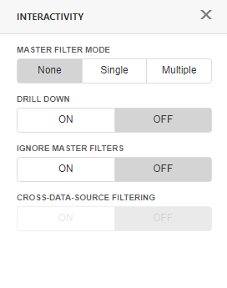
Drill - Down
The built-in drill-down capability allows you to change the detail level of data displayed in dashboard items on the fly
When Drill Down Filtering is enabled, you can view the details by double-clicking the segment.
Let’s take an example of Pie Chart. It supports drill down on Argument & Series values.
To return to the previous detail level, use the Drill Up button the icon in the Caption area.
To enable filtering across Ds, use Cross Data Source filtering.

Slide 5
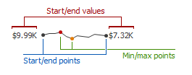
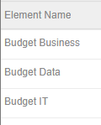
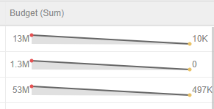
Dashboard Sparkline
A sparkline column visualizes the variation of summary values over time.
To bind the sparkline column to data, do the following.
Assign the required numeric or date-time field to Sparkline.
Assign the required Measure field to the Sparkline type property.

Slide 6
Dashboard Parameters
You can use dashboard parameters when it is necessary to pass data of a certain type to a dashboard. To Create please follow the below steps:
Invoke the Dashboard Menu and select Parameters.
In the Parameter List, click the Add New Parameter button.
Specify the parameter's settings.
Depending on the selected Look-up Settings option, you need to specify the following settings
Static List - Allows you to select a parameter value defined in a static list. To add predefined parameter values, use the + button.
Dynamic List - Allows you to select a parameter value defined in a data source. To provide access to data source values, specify the following options.
Data Source
Value Member , Display Member
Sort By , Sort Order

Slide 7
Dashboard Calculated Fields
The Web Dashboard provides the capability to create calculated fields that allow you to apply complex expressions to data fields obtained from the layout data source. As a result, you can use these fields in data visualizations as regular data source fields.
You can create calculated fields both in the Data Sources page and from the Binding panel.
Go to the layout Menu and open the Data Sources page. Select a required data source and click the Add Calculated Field button to create a calculated field.
Open the Binding Panel, go to the Binding section and click the Add calculated field button (click the icon)
This invokes the Edit Calculated Field dialog, which allows you to construct the required expression.
Use the Name option to change the default field name.
Use the Field Type option to specify the required calculated field type.
You can now create expression based on the available Elements in Expression Editor.
Fields , Constants , Functions & Operators
Save your changes.

Slide 8
Customize Control’s Appearances
This topic describes how to customize the appearance of the Web Dashboard and its elements
Conditional Formatting : Describes how to format dashboard item elements whose values meet a specified condition.
Create Format rules
Coloring : Describes how to manage coloring of dashboard item elements.
Color Scheme : The dashboard provides two ways of coloring dashboard item elements.
Global color Scheme - This color scheme provides consistent colors for identical values across the dashboard.
Local color Scheme - This color scheme provides an independent set of colors for each dashboard item.

Slide 9
Thank You.

